Slide 1

Data Visualization

Slide 2
Who are you?
I Still Don’t Know
Fill-out : Form

Slide 3
Why are We Here?
To Develop a Personal and Intimate Hate/Love Relationship With R
To Install Some Key R Packages
Tidyverse
Rmarkdown
To Practice Coding via R Scripts
To Learn Elements of ggplot2
To Practice Making Visually Stunning Pictures that Change Lives

Slide 4
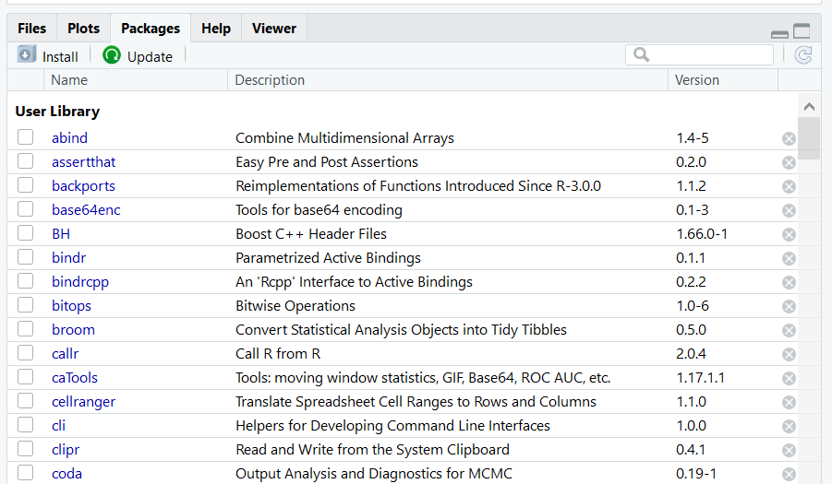
Initial Steps in RStudio
Install Tidyverse Package
Other Packages To Be Installed
RColorBrewer
RMarkdown
Select Install and Search on CRAN
> install.packages(“tidyverse”)

Slide 5
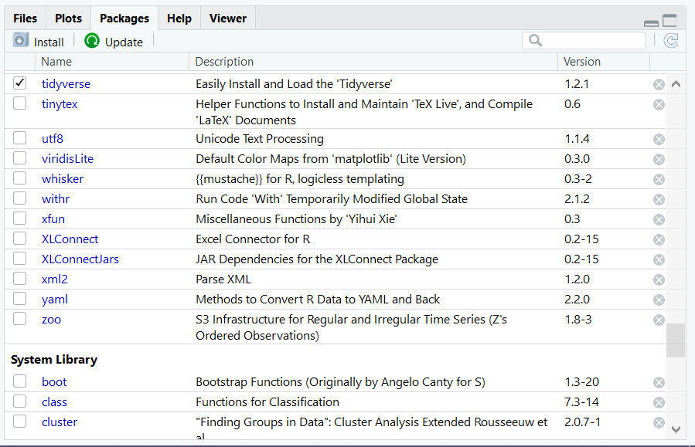
Initial Steps in RStudio
To Use the Package
Code
Check Box for Tidyverse
> library(“tidyverse”)

Slide 6
ggplot2
Help Page: Link
Comes with Preloaded Datasets

Slide 7
ggplot2
Many Useful Plots and Charts Provided
See Cheat Sheet: Link
(Also on Course Website)
Identified as Geoms (Geometric Objects)
Organized by Type of Data
Univariate
Bivariate
Mixtures of Categorical and Numeric
ggplot2 General Form
The geom you choose has to comply with the type of variables you are analyzing
Fill in blanks from dataset
> ggplot(data=DATA) +
geom_TYPE(mapping=aes(x=XVAR,y=YVAR, etc.))

Slide 8
ggplot2
Now, let us
PRACTICE
Start by downloading Tutorial2.Rmd to Your Computer from the Course Website and open the file in RStudio

Slide 9
Closing?
Disperse and Make Reasonable Decisions

